Slide 1

PROCESS MINING VIRTUAL INTERNSHIP
by
PATAN GOUSULLA
Roll No. 224G1A3222
Department of Computer Science and Engineering (Data Science)
Srinivasa Ramanujan Institute of Technology
(Affiliated to JNTUA & Approved by AICTE) (Accredited by NAAC with ‘A’ Grade & Accredited by NBA (EEE, ECE & CSE)
Rotarypuram Village, B K Samudram Mandal, Ananthapuramu – 515701.
2024 - 2025

Slide 2

Contents
Course Objective
Introduction
Technology
Applications
Modules
Real Time applications
Learning outcomes
GitHub Link
Queries

Slide 3
Course Objective
Understand the basics of process mining and its role in analyzing business processes.
Learn to automatically discover process models and perform conformance checking.
Analyze process performance to identify inefficiencies and suggest improvements.
Gain practical experience with tools like Celonis and Disco for process visualization.
Use process mining to monitor and enhance business processes continuously.

Slide 4
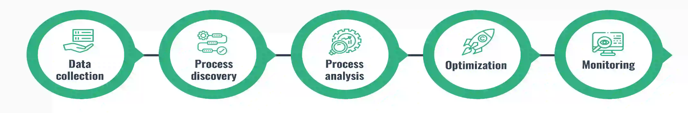
Introduction
Process Mining is a technique that helps analyze business processes using event logs from systems like ERP, CRM, and EHR.
It uncovers how processes are truly performed by discovering variations, inefficiencies, and areas for improvement.
Key Techniques:
Process Discovery: Creating models from event logs without prior knowledge of the process.
Conformance Checking: Comparing the actual process with the intended model to identify deviations.
Process Enhancement: Improving existing models with new data insights.

Slide 5
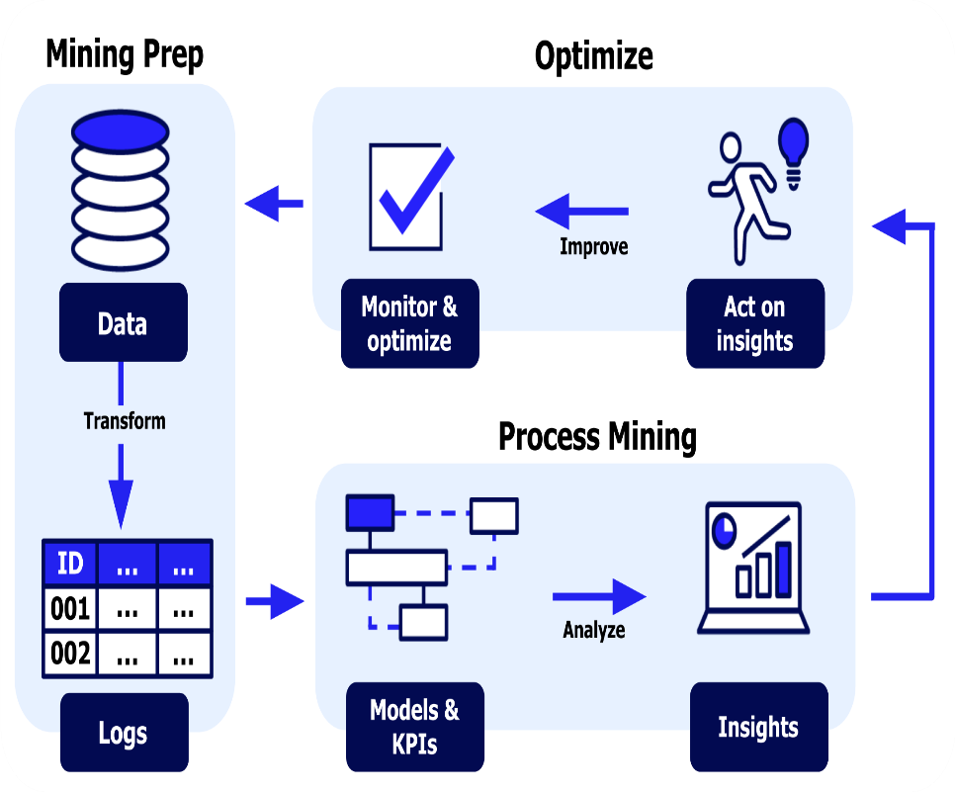
Introduction
Why Process Mining Matters:
Real-Time Insights: Provides a clear, data-driven view of how business processes actually function, not just how they are supposed to work.
Optimization: Identifies inefficiencies and suggests ways to streamline processes, improving performance and reducing costs.
Data-Driven Decisions: Helps organizations make informed decisions by uncovering hidden patterns and trends within their operations.
Scalability: Easily applies to various industries such as finance, healthcare, and manufacturing, allowing businesses to continuously improve and adapt.

Slide 6
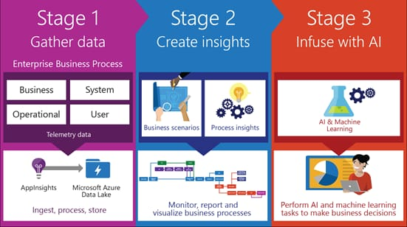
Technology
Key Technologies in Process Mining:
Process Discovery
Algorithms (Alpha Miner, Heuristic Miner)
Petri Nets: Visualize and model processes
Enhancement
Machine Learning: Predict outcomes and optimize processes
AI: Anomaly detection and process improvement
Data Integration
Big Data: Handle large-scale event logs
Cloud Platforms: Store and process data (AWS, Google Cloud)
Process Mining Tools
ProM (Open-source), Celonis (Commercial)
Visualization
Dashboards: Power BI, Tableau for real-time insights

Slide 7
Applications
Process Mining Applications:
Healthcare:
Optimizes the care treatment by releasing the delay in the waiting time by performing process analysis on patient care.
Finance:
Fraud detection as well as compliance could be improved through the ability to analyze real-time transaction processes through process mining.
Telecommunications:
This application helps improve customer service processes by facilitating process analysis on call handling and service delivery.
Retail:
This improves the customer's journey through enhancement in sales and inventory management.
Supply Chain Management:
Streamlines logistics and inventory management to reduce costs and improve delivery times.

Slide 8
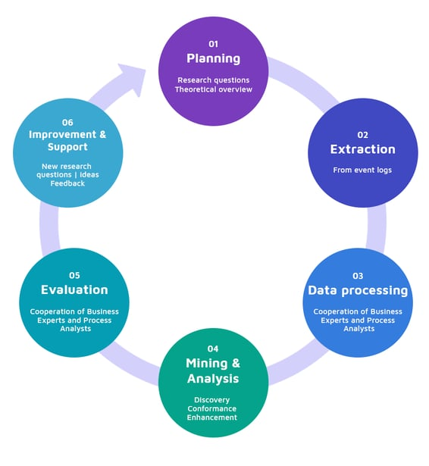
Modules
Modules of Process Mining
Planning:
Define research questions and establish a theoretical overview to guide the process mining initiative.
Extraction:
Gather data from event logs to ensure a comprehensive dataset for analysis.
Data Processing:
Collaborate with business experts and process analysts to preprocess and refine the data for mining.
Mining & Analysis:
Perform process discovery, conformance checking, and enhance process models to identify inefficiencies.
Evaluation:
Engage business experts and analysts to evaluate findings and assess process performance against standards.
Improvement & Support:
Implement new research ideas and feedback mechanisms to support ongoing enhancements in process mining efforts.

Slide 9
Real Time Applications
Real-Time Applications of Process Mining
Real-Time Monitoring:
Continuously tracks business processes to identify deviations and issues as they occur, allowing for immediate corrective actions.
Dynamic Performance Analysis:
Provides instant insights into key performance indicators (KPIs) and process efficiency, enabling quick decision-making.
Predictive Maintenance:
Analyzes live data from equipment and machinery to predict failures before they happen, reducing downtime and maintenance costs.
Fraud Detection:
Monitors transactions in real-time to detect unusual patterns or anomalies, enabling swift responses to potential fraudulent activities.
Customer Experience Optimization:
Analyzes customer interactions in real-time to enhance service delivery, resolve issues quickly, and improve overall satisfaction.
Agile Decision-Making:
Allows organizations to adapt their processes rapidly based on real-time insights, ensuring they remain competitive and responsive to changes.

Slide 10
Learning Outcomes
Understand what process mining is and the basics of how it works.
Recognize how process mining helps in the business world.
Learn to extract data to create visual representations of processes for decision-making.
Ensure compliance with regulations by identifying deviations and non-compliances in process execution.
Analyze process performance metrics and key performance indicators (KPIs).
Summarize what an event log is and its importance in process mining.
Gain skills in using process mining tools and interpreting results to enhance organizational efficiency.
Understand how process mining uncovers inefficiencies and methods for improvement.
Predict process outcomes and future behavior.
Learn about process query language.
Understand process behavior and its applications in daily life.

Slide 11
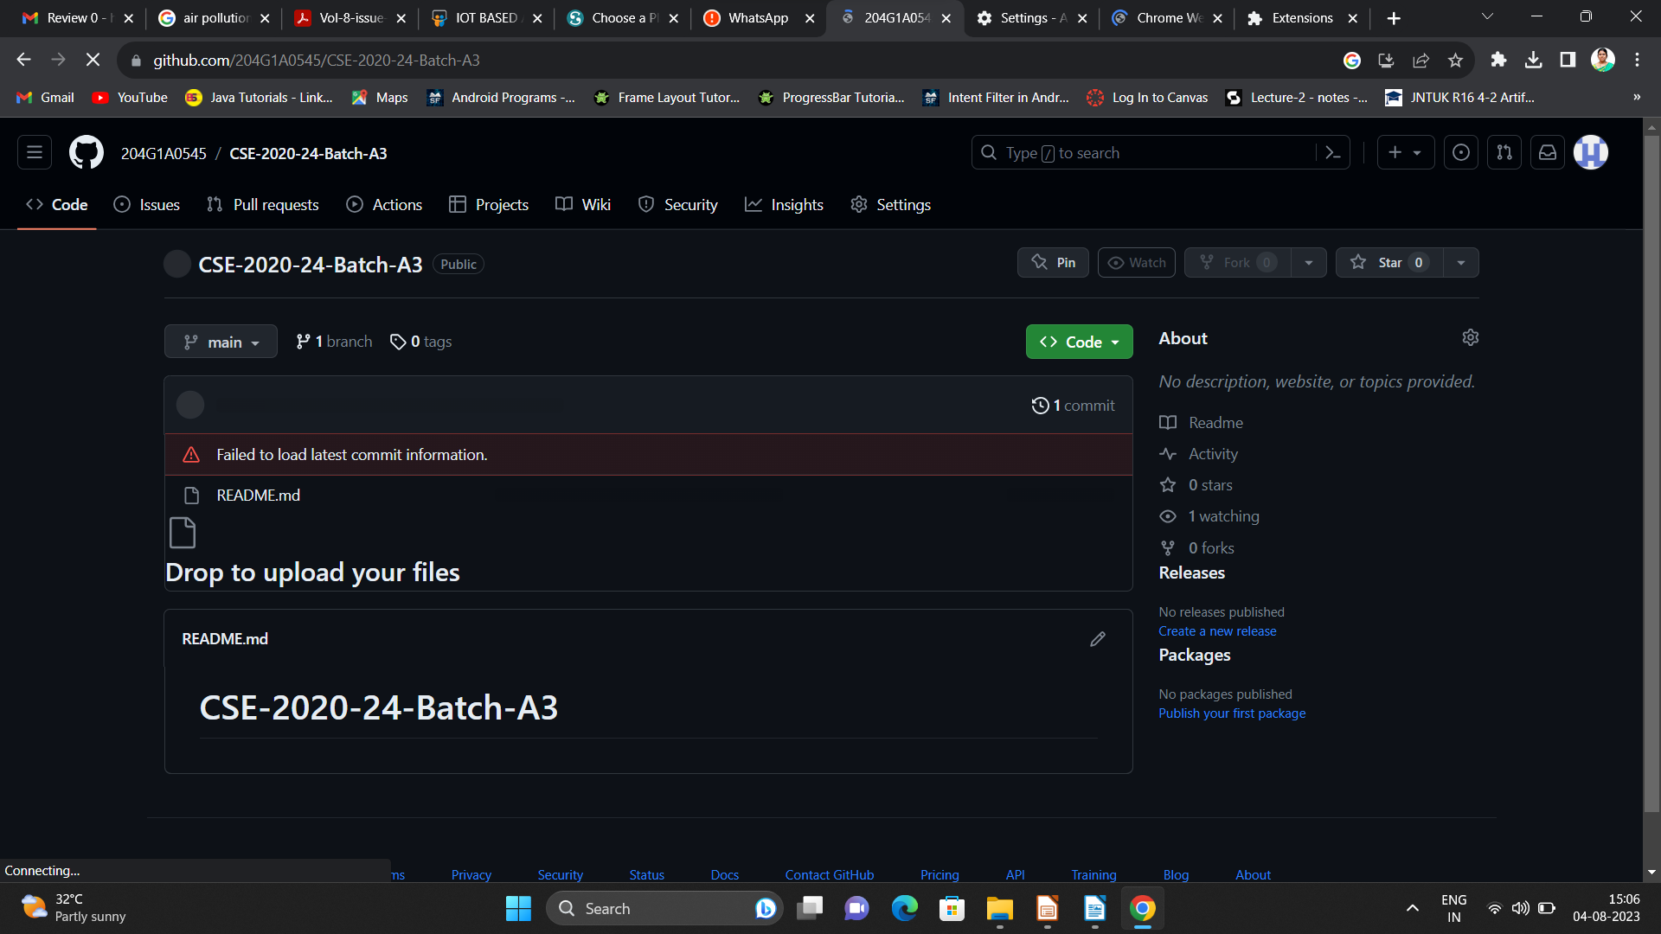

Git Hub Dashboard
Repository Name Like: Summer Internship - I
Under that include document, presentation and Certificate(Pdf).

Slide 12
Any Queries?

Slide 13
Thank You!!!

